Slide 1


DEPARTMENT OF ARTIFICIAL INTELLIGENCE AND DATA SCIENCE
AI-POWERED DEEP FAKE VIDEO DETECTION USING
BI-LSTM FOR STRENGTHENING SOCIAL MEDIA SECURITY
PRESENTED BY
ADHINARAYANAN .S - 410122243004 SASIKUMAR .P - 410122243044 SURIYAMOORTHY . K - 410122243051
SUPERVISED BY:
Ms. ASHA MARY, M.E,
ASSISTANT PROFESSOR,
AI&DS DEPARTMENT.

Slide 2
ABSTRACT
Deepfake technology has emerged as a significant threat in the digital era, enabling the creation of highly realistic yet manipulated videos that can spread misinformation, damage reputations, and compromise digital security. Detecting such fabricated media is challenging because traditional detection techniques often fail to capture subtle spatial and temporal inconsistencies present in manipulated content. This project proposes an advanced deepfake detection framework that integrates Efficient Net and Vision Transformer (VIT) models for powerful spatial feature extraction, combined with a Bidirectional Long Short-Term Memory (Bi-LSTM) network to analyze temporal relationships between video frames. The system supports both video file uploads and YouTube URL inputs, providing flexible options for real-time analysis. During processing, videos are divided into frames, facial features are extracted, and the sequence is analyzed to determine whether the content is real or fake. The system also generates a probability score to indicate prediction confidence and produces a concise authenticity report. Experimental results demonstrate strong performance, achieving a validation accuracy of 95.08%, test accuracy of 86.67%, and an F1-score of 0.87. By combining CNN and transformer-based architectures with temporal modeling, the proposed system improves accuracy, robustness, and reliability in identifying manipulated media.
Keywords: Deepfake Detection, Efficient Net, Vision Transformer (VIT), Bi-LSTM, Computer Vision, Machine Learning, Video Forensics, Artificial Intelligence, Temporal Analysis, Misinformation Detection.

Slide 3
INTRODUCTION
Deepfake technology has become a serious threat in the digital era, enabling the creation of highly realistic but manipulated videos that can spread misinformation, harm reputations, and compromise digital security. Detecting such content is difficult because traditional methods often fail to identify subtle visual and temporal inconsistencies.
To overcome these limitations, this project introduces an advanced deepfake detection framework that combines Efficient Net and Vision Transformer (VIT) to extract both detailed and global visual features from video frames.
A Bidirectional Long Short-Term Memory (Bi-LSTM) network is used to analyze temporal relationships between consecutive frames, helping to detect motion-based inconsistencies that are not visible in individual frames.
The system supports both video uploads and YouTube URL inputs, processes videos frame-by-frame , and classifies them as real or fake with a confidence score. It also generates a concise report, improving accuracy, robustness, and reliability in detecting deepfake content.

Slide 4
LITERATURE SURVEY
S.No | Title | Authors & Year | Methodology Used | Advantages | Disadvantages
1 | BMNet: Enhancing Deepfake Detection Through BiLSTM and Multi-Head Self-Attention Mechanism | Demao Xiong et al., 2024 | BiLSTM + MHSA | Captures temporal and local forgery features effectively. | High computational complexity.
2 | DeepFake Detection for Human Face Images and Videos: A Survey | A. Malik et al., 2022 | CNN, RNN, Transformer | Comprehensive survey of deepfake methods. | No new framework proposed.
3 | Generalization of Forgery Detection With Meta Deepfake Detection Model | V.-N. Tran et al., 2023 | Meta-Learning | Better generalization performance. | Requires large datasets.

Slide 5
S.No | Title | Authors & Year | Methodology Used | Advantages | Disadvantages
4 | A Survey on the Detection and Impacts of Deepfakes in Visual, Audio, and Textual Formats | R. Mubarak et al., 2023 | Multi-modal Analysis | Covers visual, audio, and text deepfakes. | Mostly theoretical survey.
5 | Improving Video Vision Transformer for Deepfake Video Detection Using Facial Landmark, Depthwise Separable Convolution and Self Attention | K. N. Ramadhani et al., 2024 | Vision Transformer + Self-Attention | High detection accuracy. | Requires high GPU resources.
6 | Local Region Frequency Guided Dynamic Inconsistency Network for Deepfake Video Detection | P. Yue et al., 2024 | Frequency Domain Analysis | Detects hidden manipulation artifacts. | High processing cost.

Slide 6
S.No | Title | Authors & Year | Methodology Used | Advantages | Disadvantages
7 | A Unified Framework of Deep Learning-Based Facial Expression Recognition System for Diversified Applications | S. Hossain et al., 2021 | Facial Expression Recognition | Good facial feature extraction. | Not specifically for deepfake detection.
8 | DiffFace: Diffusion-Based Face Swapping with Facial Guidance | K. Kim et al., 2022 | Diffusion-Based Face Swapping | Generates realistic face swaps. | Increases deepfake threats.
9 | DiffSwap: High-Fidelity and Controllable Face Swapping via 3D-Aware Masked Diffusion | S. Zhao et al., 2023 | 3D-Aware Diffusion Model | High realism and controllability. | Expensive training process.

Slide 7
S.No | Title | Authors & Year | Methodology Used | Advantages | Disadvantages
10 | Dynamic-Aware Federated Learning for Face Forgery Video Detection | Z. Hu et al., 2022 | Federated Learning | Preserves privacy and scalability. | High communication overhead.
11 | UniFormerV2: Unlocking the Potential of Image ViTs for Video Understanding | K. Li et al., 2023 | Vision Transformer | Strong temporal feature learning. | Requires massive datasets.
12 | In Ictu Oculi: Exposing AI Created Fake Videos by Detecting Eye Blinking | Y. Li et al., 2018 | Eye Blinking Detection | Lightweight detection method. | Ineffective against modern deepfakes.

Slide 8
S.No | Title | Authors & Year | Methodology Used | Advantages | Disadvantages
13 | FaceForensics++: Learning to Detect Manipulated Facial Images | A. Rossler et al., 2019 | CNN-Based Detection | Benchmark dataset for research. | Limited real-world diversity.
14 | The DeepFake Detection Challenge (DFDC) Dataset | B. Dolhansky et al., 2020 | Large-Scale Deepfake Dataset | Large and diverse dataset. | Requires huge storage and computation.
15 | Exposing DeepFake Videos by Detecting Face Warping Artifacts | Y. Li and S. Lyu, 2019 | Face Warping Artifact Detection | Effective for compressed videos. | Less effective against advanced deepfakes.

Slide 9
OBJECTIVE
Hybrid Deep Learning Framework The project aims to develop an efficient deepfake detection system by combining Efficient Net, Vision Transformer (VIT), and Bi-LSTM to leverage their strengths in feature extraction, attention, and sequence learning.
Spatial Feature Extraction & Context Learning Efficient Net extracts rich visual features from video frames, while VIT captures global contextual relationships and subtle manipulation patterns using attention mechanisms.
Temporal Analysis for Deepfake Detection Bi-LSTM analyzes sequential frame data to identify temporal inconsistencies and patterns, improving the system’s ability to detect deepfake manipulations across video sequences.
User-Friendly Detection System with Outputs The system supports video uploads and YouTube links, classifies videos as Real or Fake with confidence scores, and generates a concise report summarizing the analysis results.

Slide 10
PROBLEM STATEMENT
With the rapid advancement of deepfake technology, creating highly realistic yet manipulated videos has become increasingly accessible.
These fabricated videos pose serious risks, including the spread of misinformation, erosion of public trust, and potential security breaches. Detecting deepfakes is particularly challenging because traditional detection methods often fail to identify subtle visual and temporal inconsistencies present in these videos.
Moreover, the growing volume of online video content, including social media uploads and streaming platforms, makes manual verification impractical.
There is a pressing need for an automated, accurate, and reliable system capable of distinguishing real videos from manipulated ones while handling diverse input formats in real-time.

Slide 11
EXISTING SYSTEM
The existing systems for deepfake detection primarily rely on traditional machine learning techniques or simple deep learning models that focus only on spatial features extracted from video frames.
Many of these methods analyzes still images or individual frames without considering the temporal relationships between consecutive frames, which limits their ability to detect subtle inconsistencies present in manipulated videos.
Additionally, some existing approaches depend on handcrafted features such as facial landmarks, head pose estimation, or texture-based analysis, which often fail when deepfakes are generated using advanced generative models that minimize such artifacts.
While convolutional neural networks (CNNs) have improved detection accuracy by learning richer visual features, their performance significantly drops when applied to videos with high realism or when tested across different datasets.

Slide 12
EXISTING SYSTEM
DISADVANTAGES
Poor generalization across different datasets and platforms, leading to reduced accuracy in real-world scenarios.
Performance drops significantly when faced with high-quality, realistic deepfakes.
Low robustness, as they are easily deceived by improved generative models.

Slide 13
PROPOSED SYSTEM
The proposed system introduces a deepfake detection framework that combines spatial and temporal feature learning to improve detection performance.
Efficient Net is used to extract rich and discriminative visual features from individual video frames.
Vision Transformer (VIT) captures global contextual and attention-based features, helping detect subtle manipulation patterns.
Bi-LSTM analyzes temporal dependencies and sequential relationships between frames to identify inconsistencies in videos.
The system supports flexible input options, including video file uploads and YouTube URLs for real-world usage.
Each video is classified as Real or Fake with a probability confidence score, and a concise report is generated to summarize the results.

Slide 14
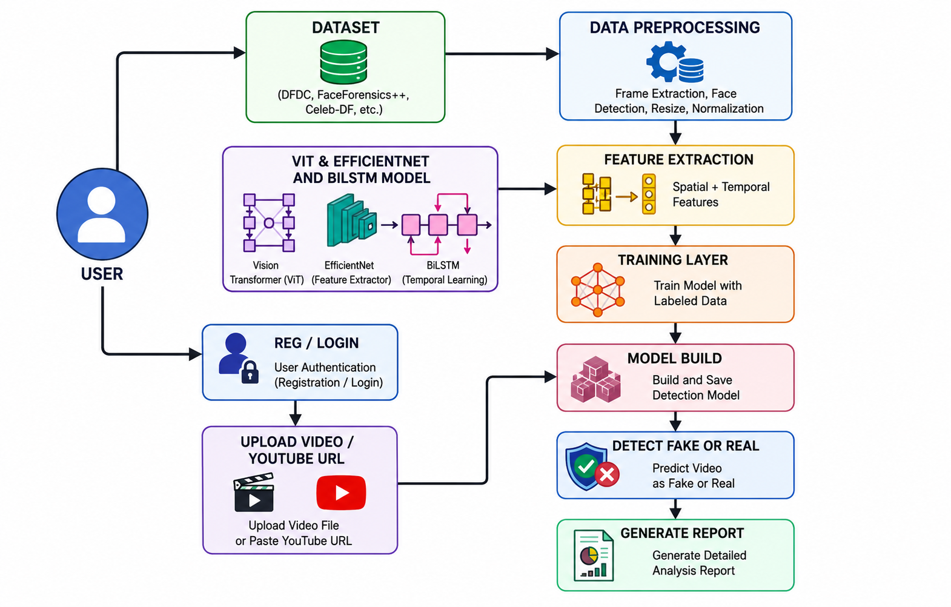
ARCHITECTURE DIAGRAM

Slide 15
SYSTEM CONFIGURATION
HARDWARE CONFIGURATION
Component | Specification
Processor | Intel Core i5 or higher
RAM | 8 GB or above
Hard Disk | 500 GB or above
SOFTWARE CONFIGURATION
Component | Specification
Operating System | Windows 10 / Windows 11
Programming Language | Python
Database | SQLite
Frontend Technologies | HTML, CSS
Libraries / Frameworks | OpenCV
Tools | Python IDLE, OpenCV, VS Code

Slide 16
LIST OF MODULES
Data Collection & Preprocessing
Feature Extraction Module (Efficient Net)
Feature Extraction Module (Vision Transformer VIT)
Temporal Sequence Learning Module (Bi-LSTM)
Classification Module
Report Generation Module

Slide 17
MODULE DESCRIPTIONS
DATA COLLECTION & PREPROCESSING
The Data Collection and Preprocessing module is responsible for gathering real and fake video datasets and preparing them for further processing. Videos are broken down into frames, and these frames are resized, normalized, and cleaned to remove noise or unwanted distortions. This ensures that the input data is consistent and suitable for training and testing the model. Proper preprocessing enhances the quality of data and improves the efficiency and accuracy of feature extraction.

Slide 18
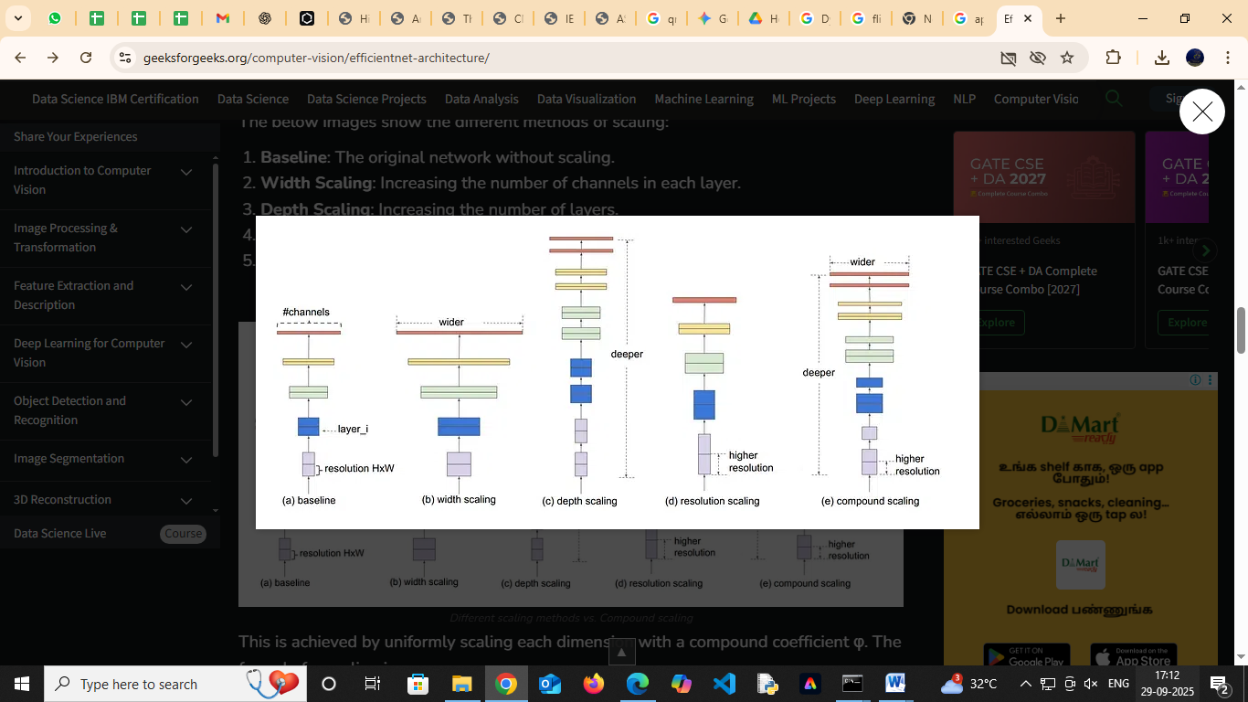
FEATURE EXTRACTION MODULE (EFFICIENT NET)
A powerful deep learning architecture, to extract rich and discriminative features from video frames. Efficient Net is chosen for its ability to achieve high accuracy with fewer parameters, making it computationally efficient while preserving important visual details. This module captures spatial patterns such as facial features, expressions, and fine-grained details that are crucial for differentiating between real and manipulated content.

Slide 19
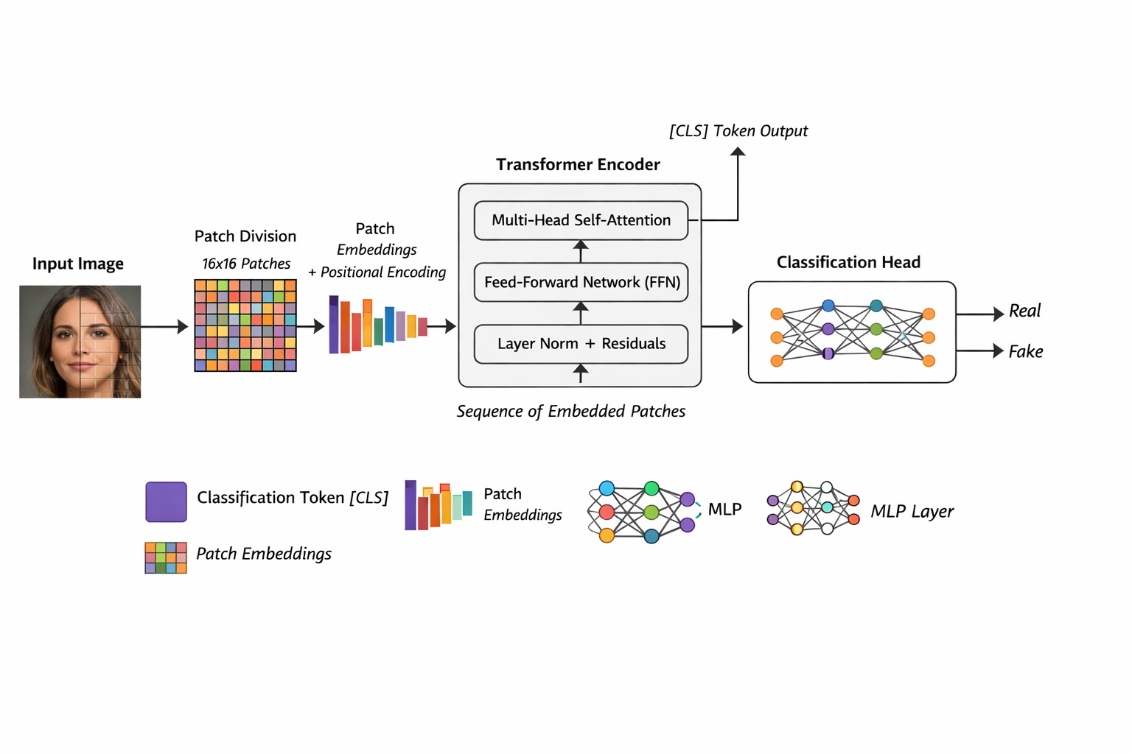
FEATURE EXTRACTION MODULE (VISION TRANSFORMER – VIT)
The Vision Transformer (VIT) extracts advanced visual features from video frames using a transformer-based
architecture. It divides each frame into small patches and processes them using a self-attention mechanism. This helps capture global relationships and important regions within the image. As a result, the model can detect subtle manipulation patterns present in deepfake videos.

Slide 20
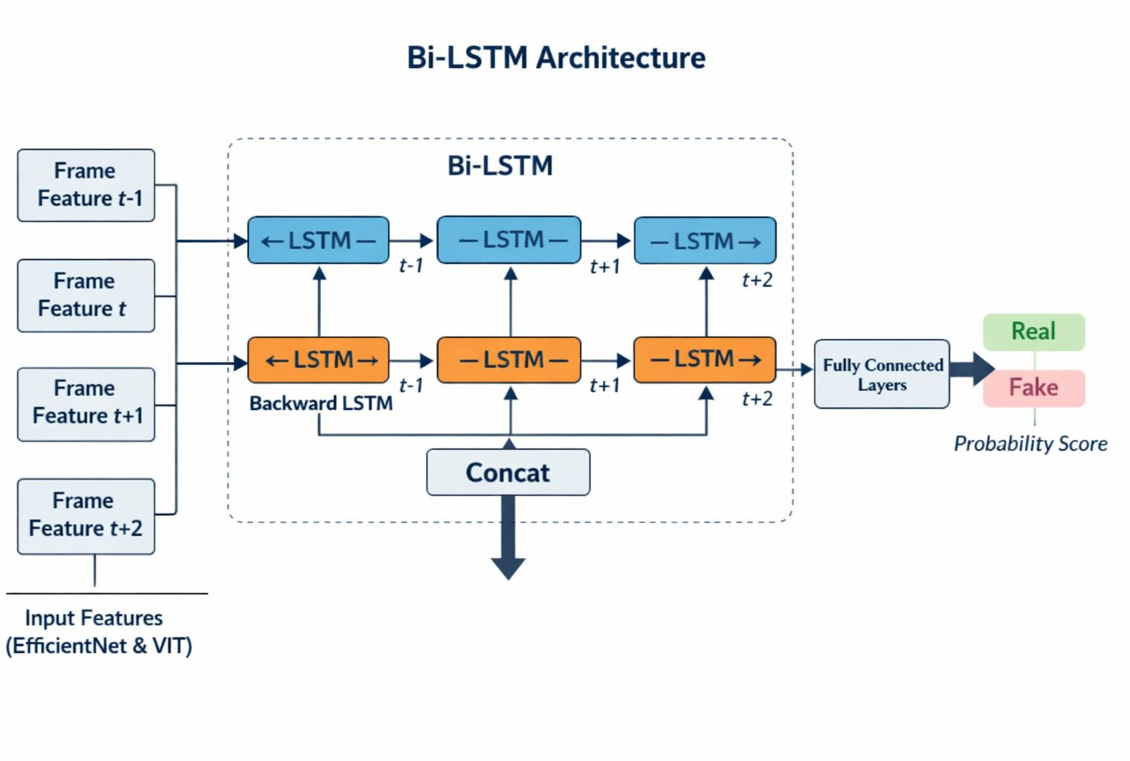
TEMPORAL SEQUENCE LEARNING MODULE (BI-LSTM)
The Temporal Sequence Learning module utilizes a Bidirectional Long Short-Term Memory (Bi-LSTM) network to analyzes the sequential nature of video frames. Unlike standard LSTM, Bi-LSTM processes information in both forward and backward directions, enabling the model to capture long-term dependencies and subtle temporal inconsistencies across frames. This module is essential in detecting manipulations that may not be visible in a single frame but become evident when observing frame-to-frame transitions.

Slide 21
CLASSIFICATION MODULE
Identifies whether the uploaded image or video is Real or Fake.
Uses deep learning models such as VIT, Efficient NetB7, and Bi-LSTM.
Performs image and video preprocessing.
Extracts frames and facial features from videos.
Analyzes spatial and temporal features of media content.
Predicts the authenticity of the uploaded content.
Displays the classification result with confidence score.
REPORT GENERATION MODULE
Generates detailed analysis reports after detection.
Stores prediction results and file details.
Displays Real/Fake detection status.
Maintains records for future reference.
Provides downloadable report generation feature.
Shows prediction accuracy and confidence values.
Helps users understand the analysis results clearly.

Slide 22
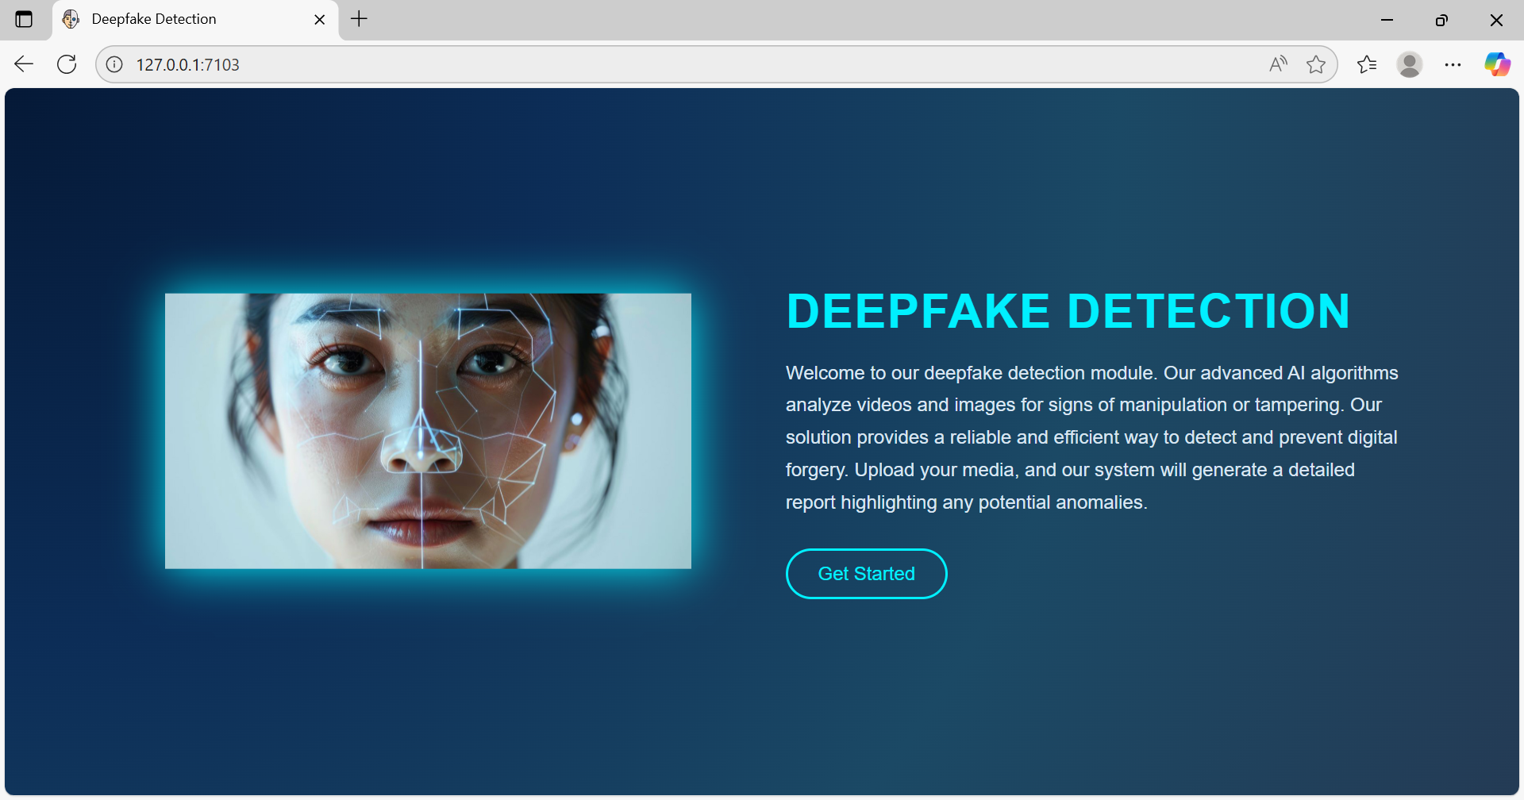
DEEPFAKE DETECTION HOME PAGE

Slide 23
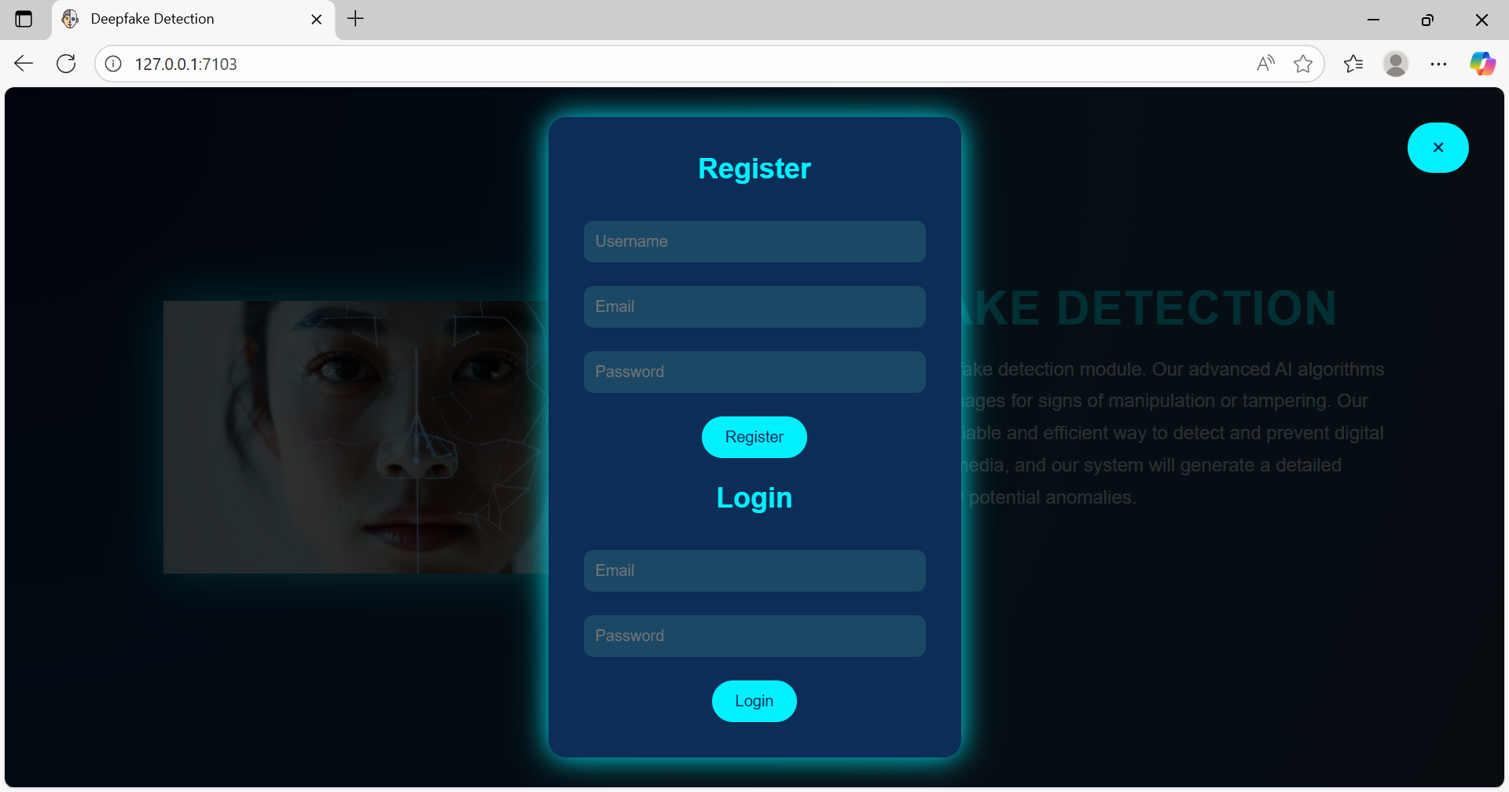
DEEPFAKE DETECTION AUTHENTICATION PAGES

Slide 24
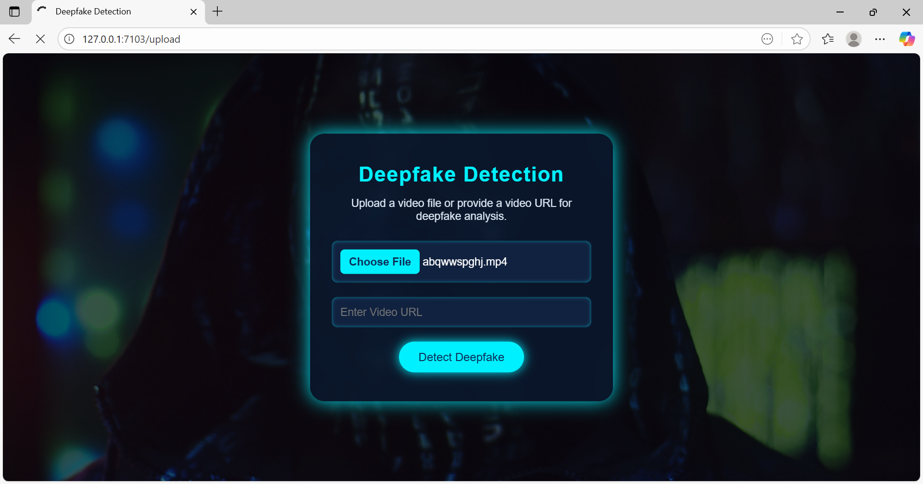
UPLOAD & YOUTUBE DETECTION

Slide 25
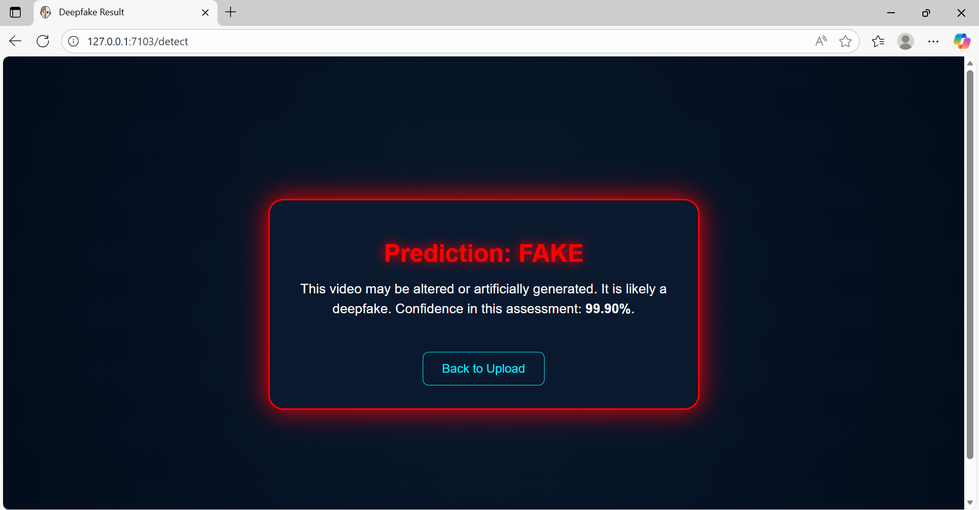
RESULT

Slide 26
CONCLUSION
The project developed a deepfake detection framework that integrates Efficient Net, Vision Transformer (VIT), and Bi -LSTM to analyze both spatial and temporal features of videos.
Efficient Net extracts detailed spatial features from video frames, while VIT captures global contextual relationships and attention-based patterns.
Bi-LSTM models temporal dependencies between consecutive frames, helping detect subtle inconsistencies in manipulated videos.
The system supports flexible input options, including video uploads and YouTube URLs, making it suitable for real-world applications.
Each video is classified as Real or Fake with a probability-based confidence score, and a concise report is generated for easy understanding.
Overall, the proposed system improves accuracy, scalability, and reliability in detecting deepfake content and helps maintain trust and security in digital media.

Slide 27
FUTURE EHANCEMENT
In the future, the deepfake detection framework can be enhanced by incorporating multimodal analysis, including audio cues, facial expressions, and speech patterns, to improve detection accuracy.
Integrating attention mechanisms or transformer-based architectures could allow the system to capture more subtle spatial and temporal inconsistencies in videos.
Additionally, expanding support for real-time streaming platforms and social media APIs would enable continuous monitoring and detection of manipulated content.
Leveraging federated learning could also allow the model to improve over time using decentralized data while preserving user privacy. These enhancements would make the system more robust, scalable, and effective in combating the evolving threat of deepfake media.

Slide 28
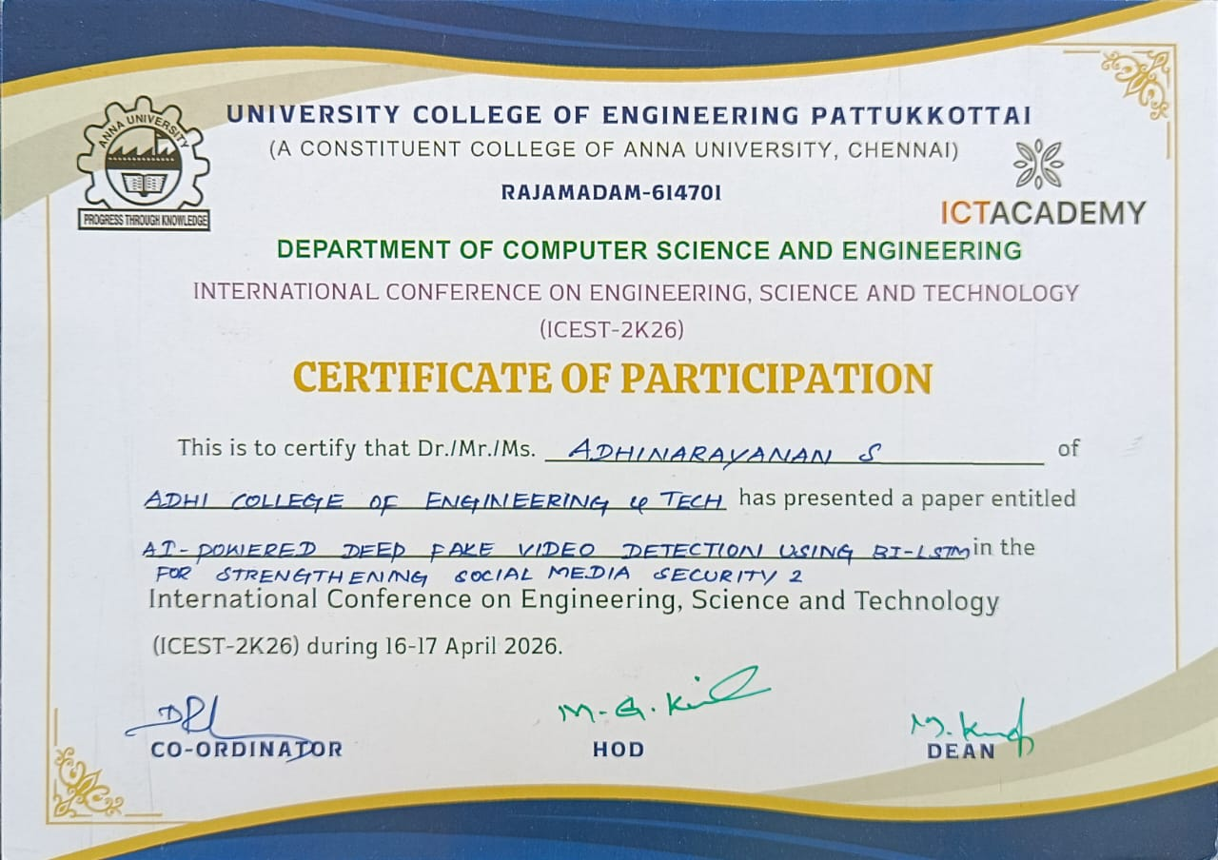

Slide 29


Slide 30


